Slide 1

307307 Introduction to Natural Language Processing

Slide 2
NLTK (Natural Language Toolkit)
NLTK (Natural Language Toolkit) is a leading platform for building Python programs that work with human language data. Developed by Steven Bird and Edward Loper at the University of Pennsylvania, NLTK has become one of the most widely used libraries for natural language processing (NLP) in Python since its initial release in 2001.
Key Features of NLTK
Comprehensive Toolkit: NLTK provides easy-to-use interfaces to over 50 corpora and lexical resources, along with a suite of text processing libraries for classification, tokenization, stemming, tagging, parsing, and semantic reasoning.
Educational Purpose: NLTK was designed with education in mind. It comes with comprehensive documentation and a book ("Natural Language Processing with Python") that makes it accessible for beginners.
Built-in Datasets: NLTK includes various pre-loaded corpora like the Brown Corpus, WordNet, and many others that are useful for training and testing NLP algorithms.
Modular Architecture: The library is organized into modules focused on specific NLP tasks, making it easy to use just the components you need.
Core Functionality
NLTK supports many essential NLP tasks:
Tokenization: Breaking text into words, sentences, or other meaningful elements
Part-of-speech tagging: Identifying the grammatical parts of speech for words
Named entity recognition: Identifying names of people, organizations, locations, etc.
Stemming and lemmatization: Reducing words to their base or root form
Parsing: Analyzing syntactic structures of sentences
Semantic analysis: Working with meaning representations
Sentiment analysis: Determining positive, negative, or neutral sentiment in text

Slide 3
Install NLTK
pip install nltk
python -m nltk.downloader all

Slide 4
Basic NLP Techniques

Slide 5
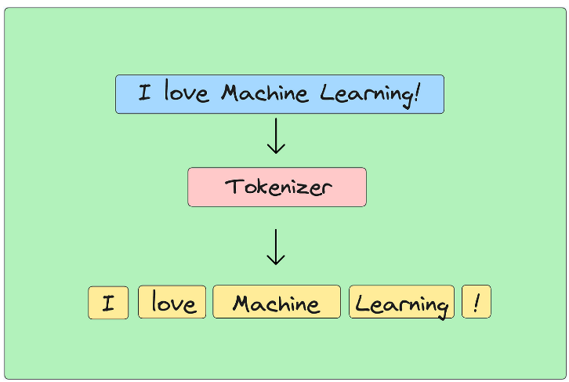
Tokenization
Tokenization is the process of breaking text into words, phrases, or other meaningful elements
Word tokenization: Splitting "I love NLP." into ["I", "love", "NLP", "."]
Subword tokenization: Breaking words into meaningful pieces (e.g., "playing" → ["play", "##ing"])
Character tokenization: Splitting text into individual characters

